Slide 1
Basic manipulations

Slide 2
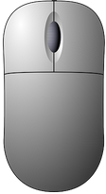
3D camera interactions
Interactions with the 3D view
  camera rotation :
    Left mouse button
  camera translation (panning) :
    Right mouse button
  zooming:
    Mouse wheel
    or +/= keys
  changing the size of points
    interactor in the upper-left corner of 3D views
    ‘Point size’ property (per cloud)

Slide 3
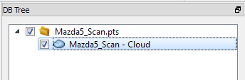
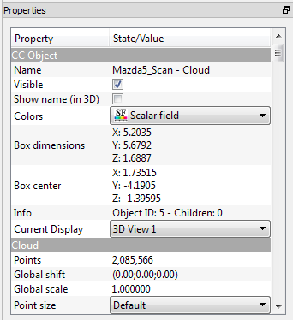
Database
Interactions with the database
  Highlight / select an entity:
    Left clik on its entry in the database
    Or left clik on the entity in the 3D view
  Toggling the visibility
    Checkbox next to the entity entry: (de)activate the entity and all its children in the database tree
    ‘Visible’ option: only the entity is hidden (not its children)
  Create a new group, displace entities inside
  Renaming an entity
    F2 or double-click with the mouse

Slide 4
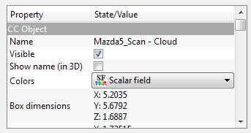
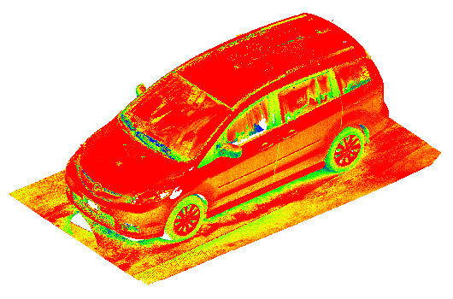
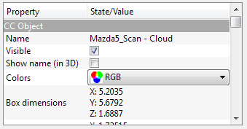
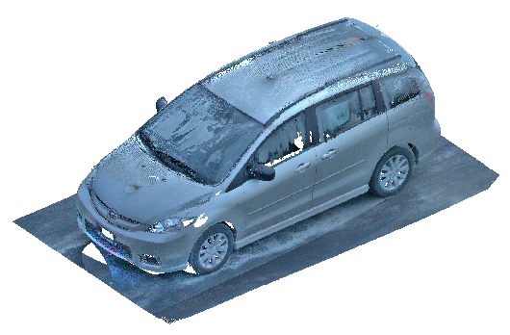
Example: change the color source

Slide 5
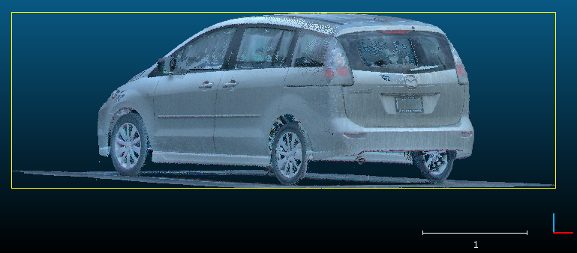
Interactive transformation
Choose the « front » view
→ Note that the road is not horizontal
X = red
Y = green
Z = blue
Select the cloud and start the tool (Edit > Segment)

Slide 6
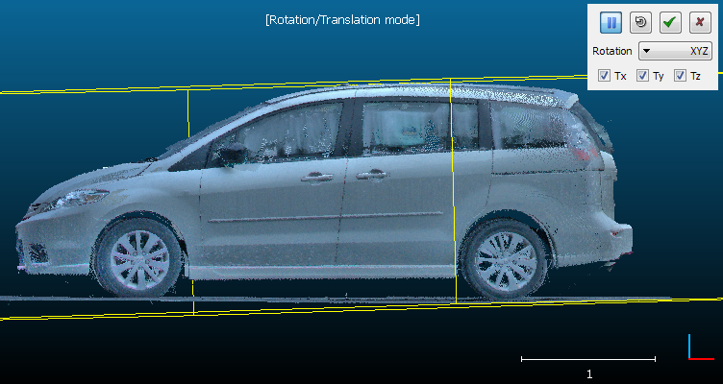
Interactive transformation
Same conventions as with the 3D camera … but now only the highlighted entities move
Options to constrain the rotation about
a given axis or the translation along
one or several axes
Warning: the bounding-box is sometimes measleding (prefer the window borders for visual alignment)
The tool can be paused anytime (to move the camera instead of the highlighted entities). The « 3D views » toolbar remains accessible.

Slide 7

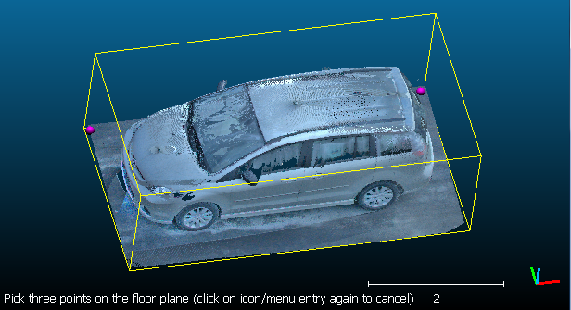
Other possibilities
Tools > Level
  Click on three points to define a plane (XY)
Other solution (indirect but more general) :
  Segment out some points on the road
  Fit a plane over them (Tools > Fit > Plane)
  Use this plane to make the cloud horizontal (see the Console for directions)

Slide 8
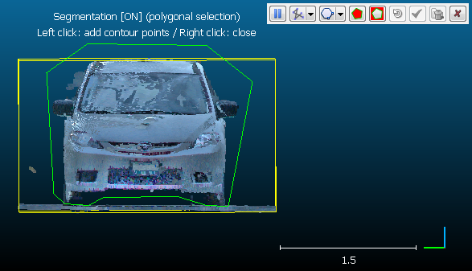
Interactive segmentation
Highlight one (or more) entities
Start the tool
Draw a polyline
  Left click: new vertex
  Right click: close the polyline
Chosse to keep points inside or outside
Notes:
  you can choose a polygonal or rectangular contour
  the tool can be paused (to rotate the camera) then restarted
  the polyline can be exported or imported from the main DB
  the « 3D views » toolbar remains accessible

Slide 9
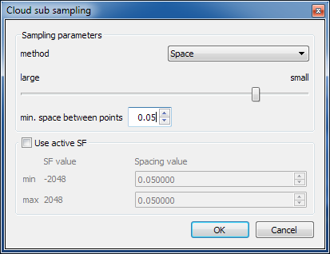
Subsampling
To reduce the size of a cloud or achieve a regular density
Higlight one or more entities and start the tool
Choose the subsampling mode:
  random
  space (spatial)
  octree (regular)
With ‘spatial’ mode, input the
minimum distance between two
points (e.g. 0.01 = 1 cm here)
The tool will select a subset of points and create a new cloud (points are not displaced)

Slide 10
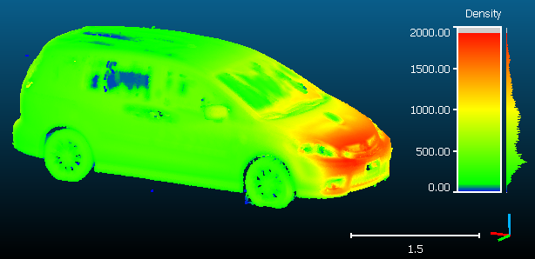
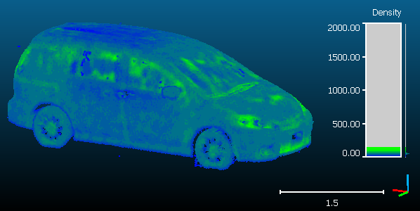
Subsampling
Original cloud
1.3M points
Subsampled cloud (1 cm)
0.26M points
Note : density can be computed with Tools > Other > Density

Slide 11
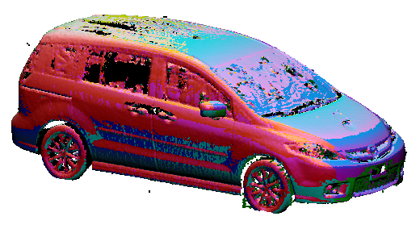
Colors and Normals edition
Edit > Colors
  Set a unique color, or « colorize » an entity
  Apply a color ramp
  RGB histogram manipulation
  Conversion to gray scale or to one or several scalar fields
Edit > Normals
  Compute normals
  Invert normals
  Orient normals
  Conversion to HSV
  Conversion to « Dip / Dip direction »

Slide 12

Scaling, cloning and merging
Edit > Multiply / Scale
  Scaling (isotropic or not)
Edit > Clone
  Duplicates an entity (manual undo ;)
Edit > Merge
  Merge two or more entities
  (only works with clouds and meshes)

Slide 13
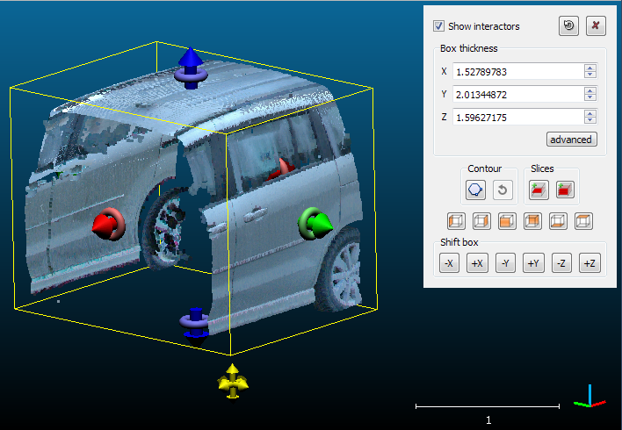
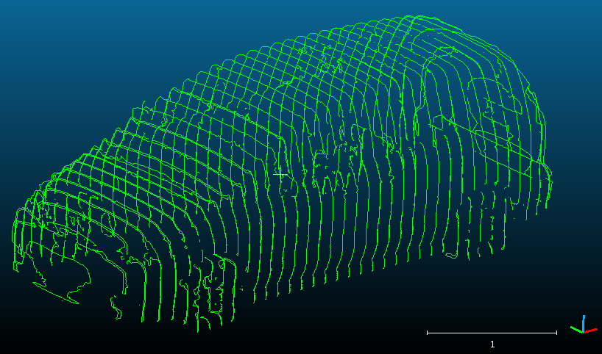
Sections
Edit > Crop
  To segment a cloud or a mesh inside a box
  Mesh segmentation is clean (triangles are remshed on the border)
Tools > Segmentation > Cross Section
  interactive or systematic sections extraction
  contours extraction (polylines)

